Slide 1

Eutrophication: Environmental Pollution and Remediation
Information Security Fundamentals | Environmental Pollution and Remediation
Course: Information Security Fundamentals | Chapter: Environmental Pollution and Remediation | Program: Bachelor of Engineering
DISCOVER · LEARN · EMPOWER
Notes:
Welcome everyone to today's lecture on Eutrophication. This topic is a critical component of our Environmental Pollution and Remediation chapter. As we explore this, remember our motto: Discover. Learn. Empower. We will dive deep into how nutrient overload transforms our water bodies.

Slide 2
Course Outcomes
SLIDE 2 / 14
Course Outcome
CO | BT LEVEL | DESCRIPTION
CO1 | BT4 | Recall, analyze and respond on fundamental environmental principles, such as ecological relationships and conservation strategies
CO2 | BT4 | Understand and analyze the interconnections between human activities and environmental impacts across different ecosystems
CO3 | BT4 | Understand and analyze and apply environmental laws and policies to analyse and propose solutions for real-world environmental challenges.
CO4 | BT2 | Students will analyse data from environmental monitoring programs to assess trends and predict future impacts on ecosystems.
CO5 | BT6 | Interpret, elaborate and propose various tools, design and innovative strategies for sustainable development and environmental conservation initiatives in securing the planet.
Chandigarh University
2 / 14
Notes:
Today's lecture directly addresses Course Outcome 2. You will learn to analyze how human activities like fertilizer runoff directly cause environmental impacts in aquatic ecosystems. This connection is the core of understanding eutrophication. By the end, you will see the direct line from human action to ecosystem collapse.

Slide 3
Learning Objectives
SLIDE 3 / 14
Learning Outcomes
1
Define eutrophication and distinguish between natural and cultural processes.
2
Analyze the specific role of nitrogen and phosphorus in nutrient loading.
3
Evaluate the ecological consequences of algal blooms and hypoxia.
4
Calculate the rate of nutrient accumulation in a specific water body.
5
Propose remediation strategies to mitigate the effects of eutrophication.
Chandigarh University
3 / 14
Notes:
By the end of this session, you will be able to define eutrophication clearly. You will analyze why nitrogen and phosphorus are the primary culprits. We will also evaluate the severe consequences like hypoxia. Finally, you will calculate nutrient rates and propose real-world solutions.

Slide 4
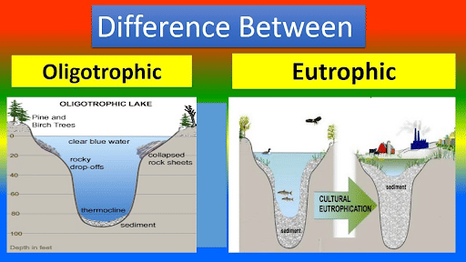
Lecture
SLIDE 4 / 14
Definition and Natural Process
1
Eutrophication is the gradual enrichment of water bodies with nutrients.
2
Natural eutrophication occurs over centuries through geological weathering processes.
3
It leads to increased plant growth and eventual lake aging.
4
The process is slow and allows ecosystems to adapt gradually.
5
Natural nutrient sources include decaying organic matter and soil runoff.
6
This stage represents the final phase of a lake's life cycle.
7
The water body eventually fills with sediment and becomes terrestrial.
Characteristics of Oligotrophic and Eutrophic Lakes - Environment Notes
Chandigarh University
4 / 14
Notes:
Let's start with the definition. Eutrophication is the enrichment of water with nutrients. In nature, this is a slow process taking centuries. It is essentially the aging of a lake. Think of it as a natural lifecycle where the lake slowly fills with sediment over thousands of years.

Slide 5
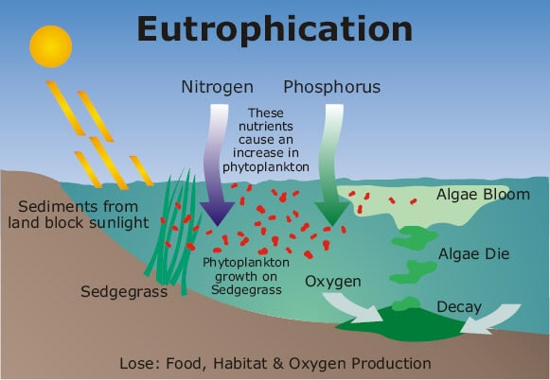
Lecture
SLIDE 5 / 14
Cultural Eutrophication Causes
1
Cultural eutrophication is accelerated by human activities and industrial waste.
2
Agricultural runoff carries excess fertilizers into nearby water bodies.
3
Sewage discharge introduces high levels of phosphates and nitrates.
4
Industrial effluents often contain detergents rich in phosphorus compounds.
5
Deforestation increases soil erosion and nutrient loading into streams.
6
Urban stormwater runoff carries pollutants from paved surfaces directly.
7
This process accelerates lake aging from centuries to mere decades.
Water Eutrophication and its Effect • EnvGuide (source: us.envguide.com)
Chandigarh University
5 / 14
Notes:
Now, consider cultural eutrophication. This is driven by human activity. Agricultural runoff is a major source, carrying fertilizers directly into water. Sewage and industrial effluents also contribute significantly. This accelerates the aging process from centuries to just decades, causing rapid ecological damage.

Slide 6
Key Nutrients
SLIDE 6 / 14
Nitrogen and Phosphorus
1
Phosphorus is often the limiting nutrient in freshwater ecosystems.
2
Nitrogen is frequently the limiting nutrient in marine and estuarine systems.
3
Excess phosphorus triggers rapid algal growth and surface blooms.
4
Nitrates from fertilizers are highly soluble and leach into groundwater.
5
Phosphates from detergents bind to soil but wash away easily.
6
Controlling phosphorus input is the primary strategy for freshwater remediation.
7
Both nutrients act as catalysts for explosive biological productivity.
Chandigarh University
6 / 14
Notes:
Which nutrient is the problem? In freshwater, phosphorus is usually the limiting factor. In marine systems, nitrogen often limits growth. Excess phosphorus triggers rapid algal blooms. Controlling phosphorus input is our primary strategy for freshwater remediation. Both act as catalysts for explosive growth.

Slide 7
Ecological Consequences
SLIDE 7 / 14
Algal Blooms
1
Algal blooms create dense surface layers blocking sunlight penetration.
2
Submerged aquatic plants die due to lack of photosynthesis.
3
Toxic cyanobacteria produce toxins harmful to aquatic life and humans.
4
Bloom collapse leads to massive oxygen depletion in the water.
5
Fish kills occur due to suffocation and toxic exposure.
6
Water quality degrades, making it unsuitable for recreation or use.
7
Biodiversity drops as sensitive species are eliminated from the system.
Chandigarh University
7 / 14
Notes:
The immediate consequence is an algal bloom. These dense layers block sunlight, killing underwater plants. Toxic cyanobacteria can produce harmful toxins. When the bloom collapses, oxygen levels plummet. This leads to massive fish kills and a complete loss of biodiversity in the affected area.

Slide 8
Ecological Consequences
SLIDE 8 / 14
Hypoxia
1
Hypoxia refers to critically low dissolved oxygen levels in water.
2
Decomposition of dead algae consumes dissolved oxygen rapidly.
3
Anaerobic bacteria thrive, producing toxic hydrogen sulfide gas.
4
Fish and mobile organisms flee the hypoxic zone to survive.
5
Sessile organisms like clams die due to lack of oxygen.
6
Dead zones form where no aerobic life can exist.
7
Recovery of oxygen levels takes years after nutrient input stops.
Chandigarh University
8 / 14
Notes:
The most severe consequence is hypoxia. Decomposition of dead algae consumes oxygen rapidly. Anaerobic bacteria take over, producing toxic hydrogen sulfide. Mobile organisms flee, but sessile ones die. This creates dead zones where no aerobic life can survive for years.

Slide 9
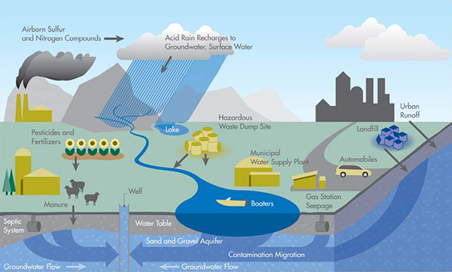
Worked Example
SLIDE 9 / 14
Nutrient Loading
GOVERNING EQUATION
Calculate annual phosphorus load: Load = Flow Rate × Concentration
GIVEN
River flow = 500 m³/day and P-concentration = 0.05 mg/L.
CONVERT UNITS
0.05 mg/L equals 0.05 g/m³ for calculation.
• Load = 500 m³/day × 0.05 g/m³ = 25 grams/day.
• Annual load = 25 g/day × 365 days = 9,125 grams/year.
• This equals 9.125 kg of phosphorus entering the lake annually.
• Exceeding 0.01 mg/L often triggers eutrophication in sensitive lakes.
Source: www.mrgscience.com
Chandigarh University
9 / 14
Notes:
Let's do a quick calculation. If a river flows at 500 cubic meters daily with 0.05 mg/L of phosphorus, the load is 25 grams per day. Over a year, that is 9.125 kilograms. This simple math shows how small concentrations add up to massive loads that trigger eutrophication.

Slide 10

Lecture
SLIDE 10 / 14
Common Pitfalls in Analysis
1
Assuming nitrogen is always the limiting nutrient in all waters.
2
Ignoring the role of internal loading from lake sediments.
3
Overlooking point sources like sewage treatment plant discharges.
4
Believing that stopping external input instantly reverses the damage.
5
Confusing eutrophication with general water pollution or acidification.
6
Neglecting the time lag between nutrient reduction and recovery.
7
Focusing only on algae without considering the oxygen cycle.
Source: static.vecteezy.com
Chandigarh University
10 / 14
Notes:
Watch out for common pitfalls. Do not assume nitrogen is always the limiting factor. Internal loading from sediments is often ignored. Stopping external input does not instantly reverse damage. There is a significant time lag. Always consider the oxygen cycle, not just the algae.

Slide 11
Remediation
SLIDE 11 / 14
Source Control
1
Reduce fertilizer application rates in agricultural zones significantly.
2
Upgrade sewage treatment plants to remove phosphates effectively.
3
Install buffer strips of vegetation along water bodies.
4
Ban phosphorus-containing detergents in residential areas.
5
Implement stormwater management systems to filter runoff.
6
Enforce strict regulations on industrial effluent discharge limits.
7
Promote sustainable farming practices to minimize soil erosion.
Chandigarh University
11 / 14
Notes:
Remediation starts with source control. We must reduce fertilizer use and upgrade sewage treatment. Installing buffer strips of vegetation helps filter runoff. Banning phosphorus detergents is crucial. These measures prevent nutrients from entering the water in the first place.

Slide 12
Remediation
SLIDE 12 / 14
In-Lake Strategies
1
Aeration systems increase dissolved oxygen to support aerobic life.
2
Dredging removes nutrient-rich sediments from the lake bottom.
3
Chemical precipitation uses alum to bind phosphorus in water.
4
Biomanipulation introduces fish species that eat algae-eating zooplankton.
5
Harvesting algae physically removes nutrients from the ecosystem.
6
Covering sediments prevents internal phosphorus release into the water.
7
These methods are expensive and require long-term maintenance.
Chandigarh University
12 / 14
Notes:
For existing pollution, we use in-lake strategies. Aeration increases oxygen levels. Dredging removes nutrient-rich sediments. Chemical precipitation binds phosphorus. Biomanipulation adjusts the food web. These methods are effective but expensive and require long-term maintenance to sustain results.

Slide 13
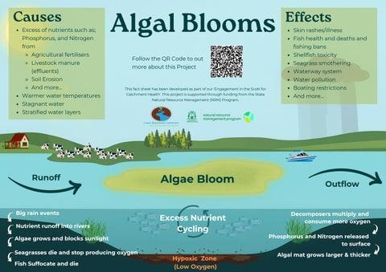
Lecture
SLIDE 13 / 14
Key Takeaways
1
Eutrophication is nutrient enrichment causing rapid algal blooms and hypoxia.
2
Human activities accelerate natural aging processes from centuries to decades.
3
Phosphorus is the primary limiting nutrient in freshwater ecosystems.
4
Remediation requires both source control and in-lake treatment strategies.
5
Understanding nutrient loading calculations is essential for management.
Source: image.isu.pub
Chandigarh University
13 / 14
Notes:
To summarize, eutrophication is nutrient enrichment causing rapid blooms. Human activities accelerate this process significantly. Phosphorus is the key limiting nutrient in freshwater. Effective remediation requires both stopping the source and treating the lake. Understanding the math behind nutrient loading is essential for management.

Slide 14
Lecture
SLIDE 14 / 14
References
ENVIRONMENTAL STUDIES
From Crisis to Cure — R. Rajagopalan
• Environmental Science and Engineering — Benny Joseph
• Environmental Studies — R.C. Sharma and D. Gurbir Sangha
• Introduction to Environmental Science — Anjaneyulu, Y.
• Environmental Pollution Control Engineering — C.S. Rao
• Textbook of Environmental Studies for undergraduate courses — E. Bharucha
• Environmental Science — S.C. Santra
Chandigarh University
14 / 14
Notes:
These are the reference books for this lecture. They provide detailed insights into environmental science and pollution control. Please review the chapters on water pollution and remediation for further study. Thank you for your attention today.

